Slide 1

©Lisa Kristine
October 10th – St. Daniel Comboni
the Comboni Spirituality and the commitment against slavery

Slide 2
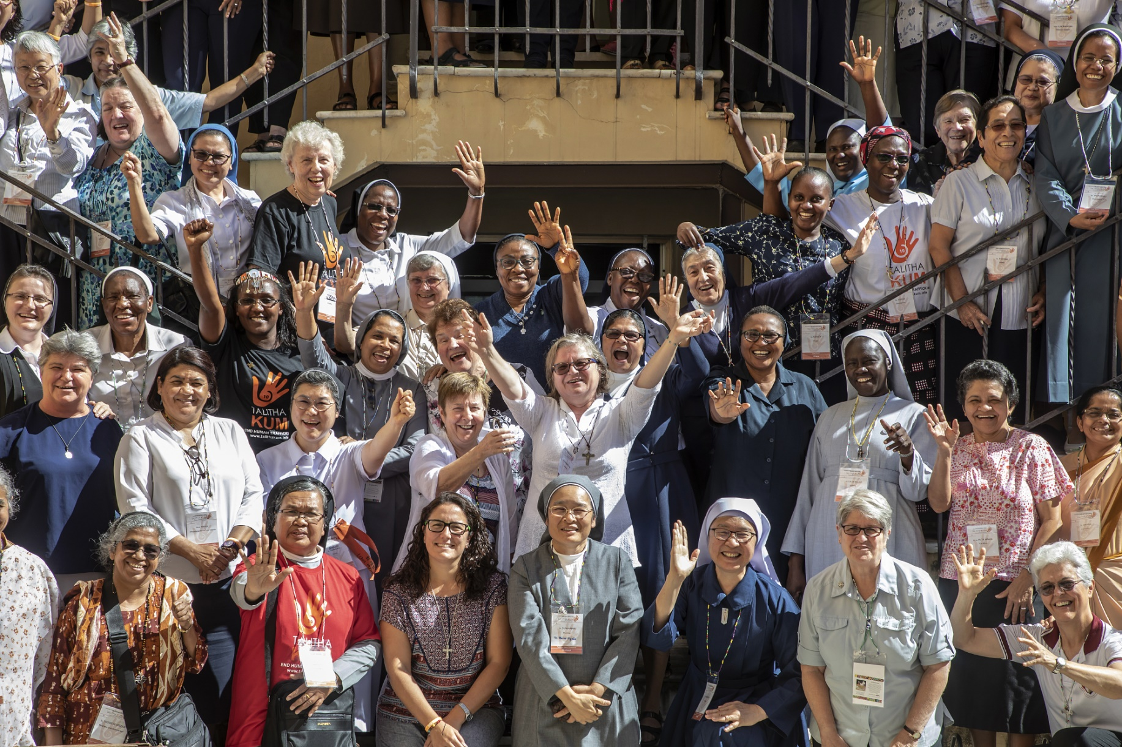
Talitha Kum International
by Sr. Gabriella Bottani, smc

Slide 3

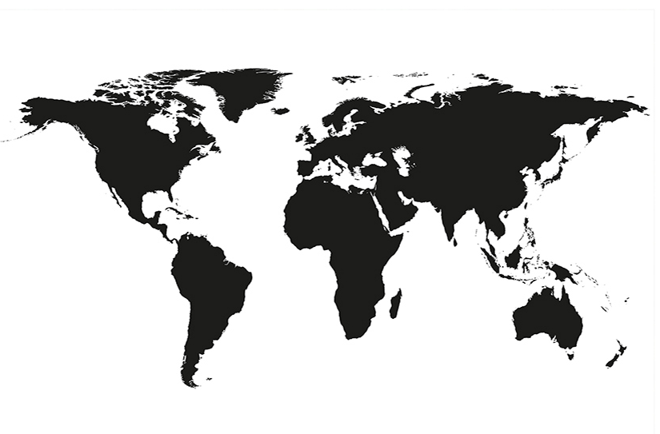

56 active groups

Slide 4
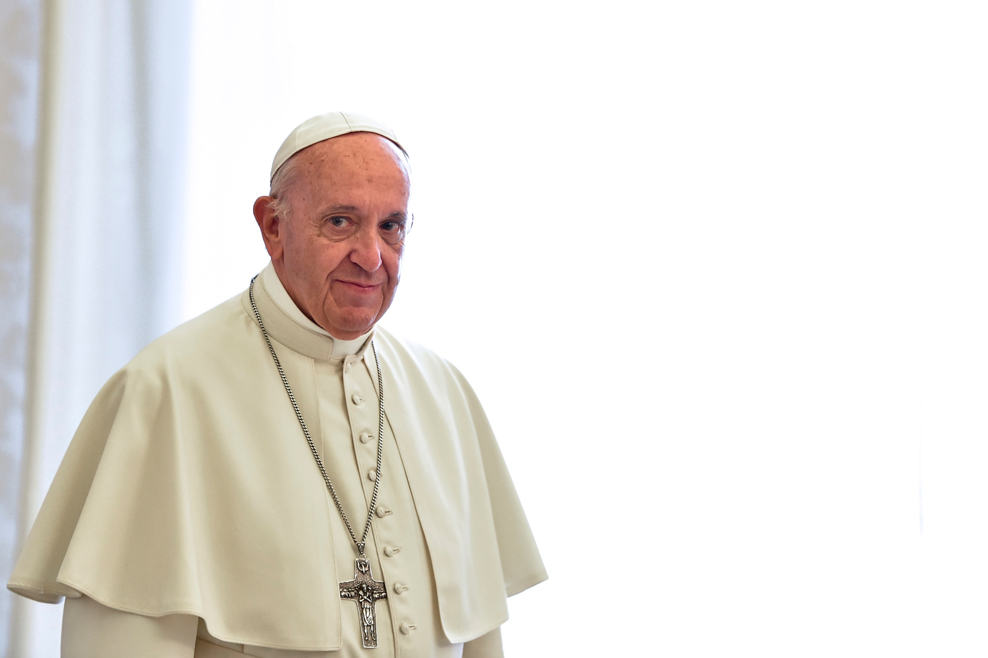

Among so many open wounds in our world, one of the most troubling is the trade in human beings, … which violates the God-given dignity of so many of our brothers and sisters [...].
Pope Francis, Greeting to the Second European Assembly of RENATE, 7 November 2016

Slide 5
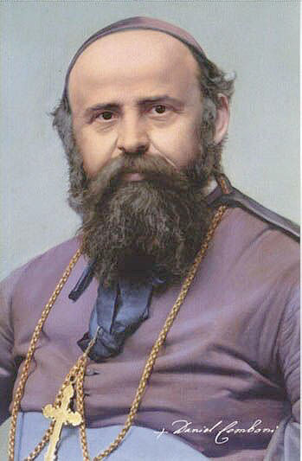
But among all the scourges that distress these most unfortunate countries where the devil reigns as lord, there is none greater or more deeply rooted than slavery.
Daniel Comboni

Slide 6
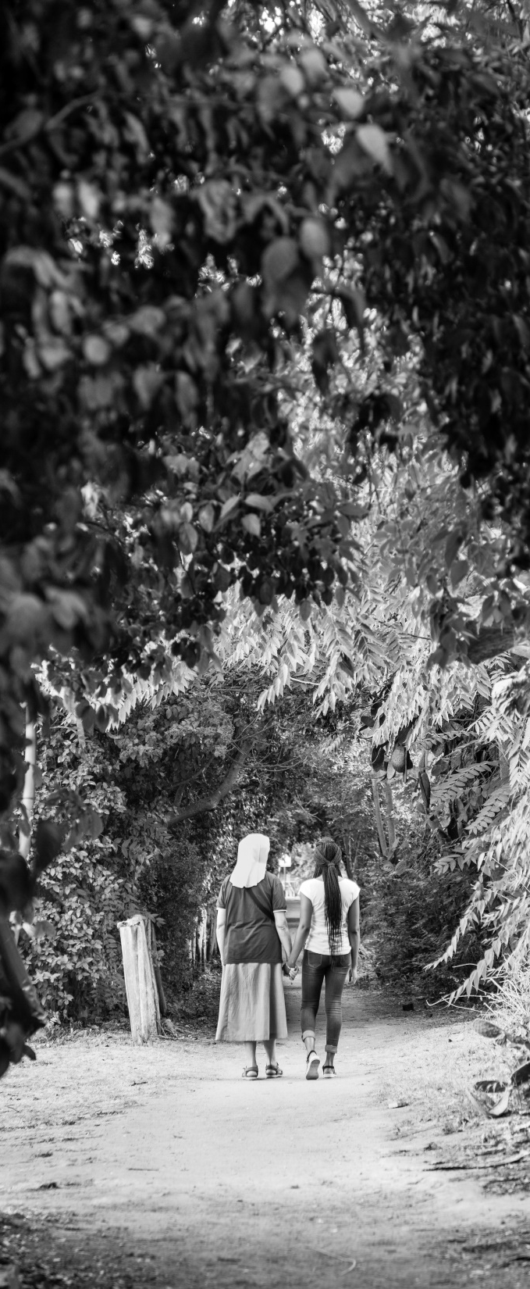
We are working, in the scraps of time stolen from our other occupations, on a report … on the horrors of slavery and the slave trade which is in full force. The Heart of Jesus will help us to accomplish successfully this part of our mission for the Vicariate. I have bought and paid for a very poor piece of land one hour away from El Obeid, where I will send the freed slaves to work and live off its produce.
(Comboni 3379)

Slide 7
If Monisgnore saw some naked and dirty slave, he would turn to those close to him and say that there “he/she is my soon/daughter too”, and while speaking his tears would sprout
Teresa Grigolini, letter to her brother – november 1881

Slide 8
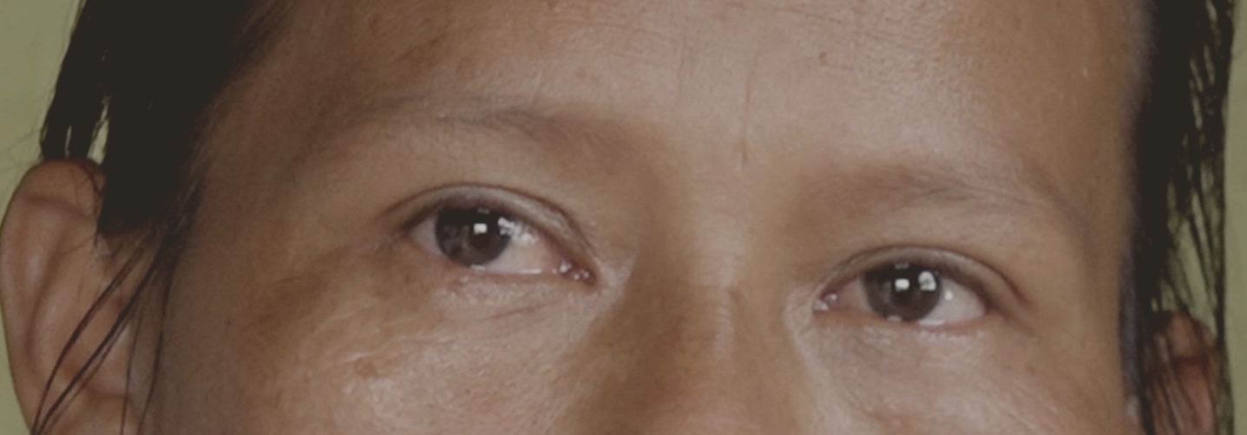
Mary – the eyes of God

Slide 9
Maria's daughter (India Ticuna) was 12 years old when she was released from the house where she was locked up and forced into prostitution, along with 8 other teenagers.
After a time spent away, in Manaus, the girl has returned home, but she cannot live with her mother and her brothers. She continues to be considered a "prostitute" and suffers violence from the men of the village.
Maria, the mother, said while crying: The others see in my daughter only a bad girl, a girl who seduces and who has returned only to create problems, to steal boyfriends and husbands. For everyone she is guilty. To me she is my daughter.

Slide 11
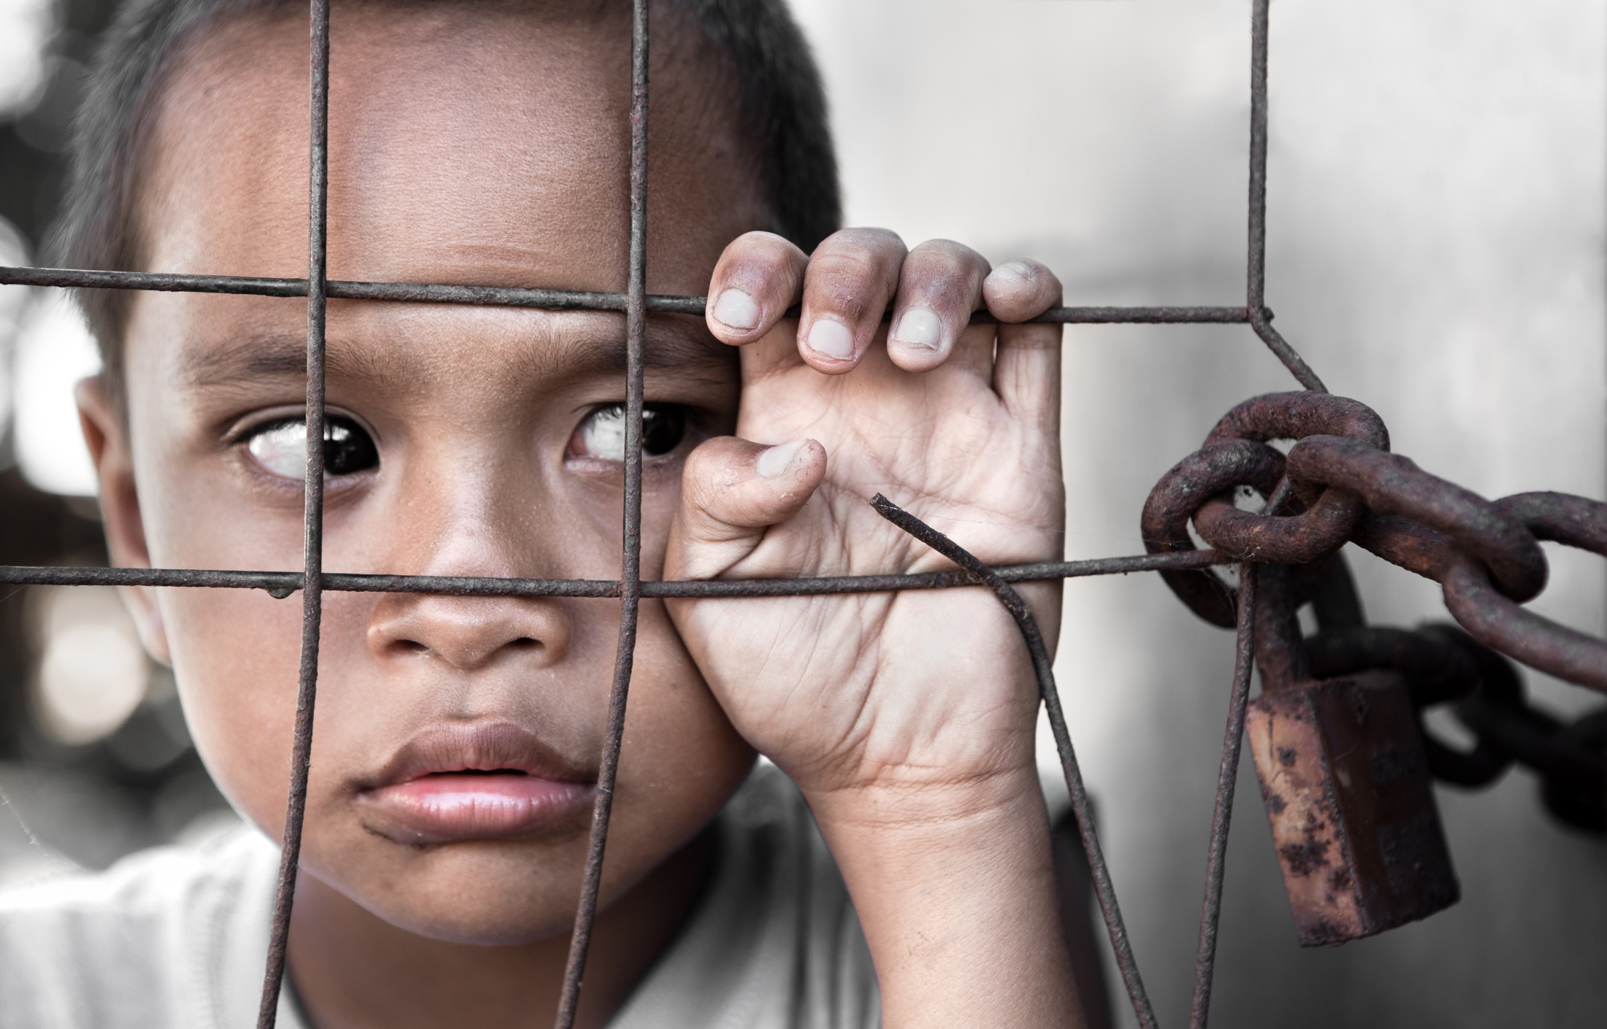
Human trafficking is growing in all countries!!

Slide 12
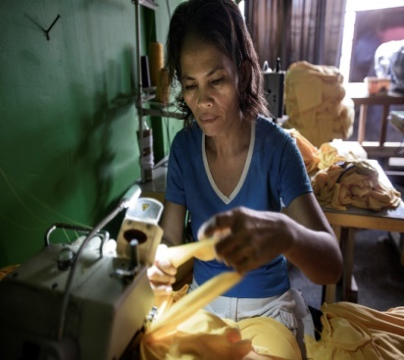

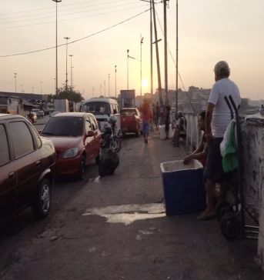
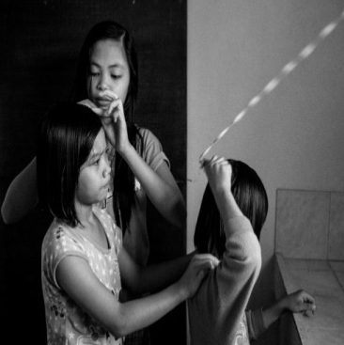
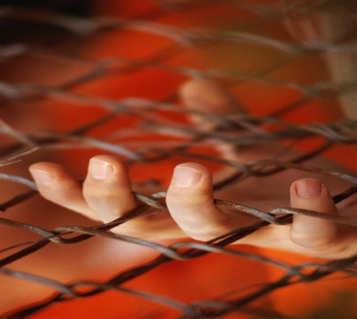
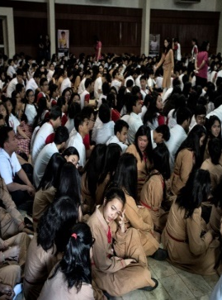
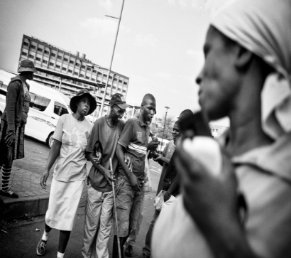
Trafficking in Persons
Is an “atrocious scourge,” an “aberrant plague” and an “open wound on the body of contemporary society.”
The commodification of life
The restriction of freedom

Slide 13
Trafficking in Persons
40 millions of people
72% women
1 every 3 trafficked person is under18
It happens everywhere
Trafficking is a global business of 150 billion dollars
Low-risk crime: in 2019 every 2154 estimated victims of trafficking in persons … there was only 1 prosecution of a trafficker

Slide 14
Domestic Servitude
Forced labor
Organ removal
Begging
Criminal Acts
Forced Marriage
Sexual Exploitation

Slide 15
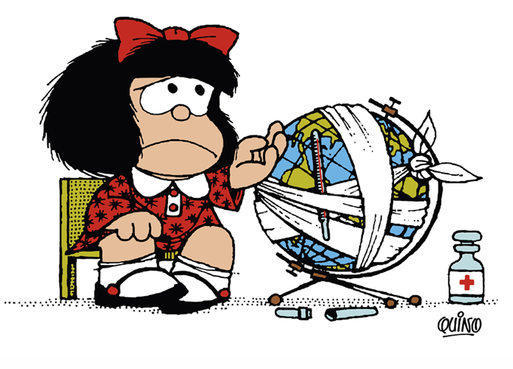
V. GLOBAL INEQUALITY : (LS 48) The human environment and the natural environment deteriorate together; we cannot adequately combat environmental degradation unless we attend to causes related to human and social degradation.

Slide 16
…“even though the international community has adopted numerous agreements aimed at ending slavery in all its forms, and has launched various strategies to combat this phenomenon, millions of people today – children, women and men of all ages – are deprived of freedom and forced to live in conditions akin to slavery…
Today, as in the past, slavery is rooted in a notion of the human person that allows him or her to be treated as an object…
Whether by coercion, or deception, or by physical or psychological duress, human persons created in the image and likeness of God are deprived of their freedom, sold and reduced to being the property of others. They are treated as means to an end… [Criminal networks] are skilled in using modern means of communication as a way of luring young men and women in various parts of the world”.

Slide 17
A perversion that exceeds all limits when it subjugates women and then forces them to abort. An abomination that goes to the length of kidnapping persons for the sake of selling their organs.
Trafficking in persons and other contemporary forms of enslavement are a worldwide problem that needs to be taken seriously by humanity as a whole: “since criminal organizations employ global networks to achieve their goals, efforts to eliminate this phenomenon also demand a common and, indeed, a global effort on the part of various sectors of society”. (FT 24)

Slide 18
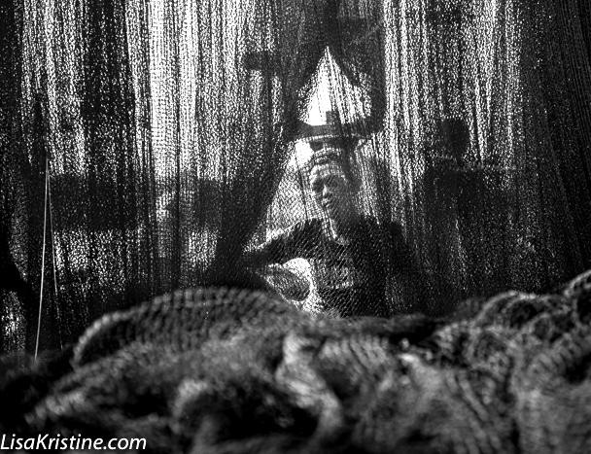
When spider webs unite,
they can tie up a lion
If you want to go fast, go alone.
If you want to go far, go together.
(African Proverbs)

